Slide 1
Understanding of Condition Flag bits in CPSR – ARM7TDMI
Dr V Ananthanarayanan

Slide 2
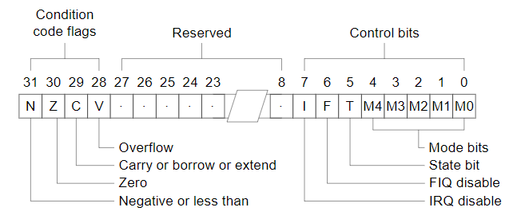
Recall
N: Negative
The N flag is set by an instruction if the result is negative. In practice, N is set to the two's complement sign bit of the result (bit 31).
Z: Zero
The Z flag is set if the result of the flag-setting instruction is zero.

Slide 3
C: Carry (or Unsigned Overflow)
The C flag is set if the result of an unsigned operation overflows the 32-bit result register. This bit can be used to implement 64-bit unsigned arithmetic. ARM uses an inverted carry flag for borrow (i.e. subtraction). That's why the carry flag is set whenever there is no borrow and clear whenever there is Borrow. ( As a result of SUBS, C = 1 indicates No Borrow and C = 0 indicates Borrow )
V: (Signed) Overflow
The V flag works the same as the C flag, but for signed operations. For example, 0x7fffffff is the largest positive two's complement integer that can be represented in 32 bits, so 0x7fffffff + 0x7fffffff triggers a signed overflow, but not an unsigned overflow (or carry): the result, 0xfffffffe, is correct if interpreted as an unsigned quantity, but represents a negative value (-2) if interpreted as a signed quantity.

Slide 4
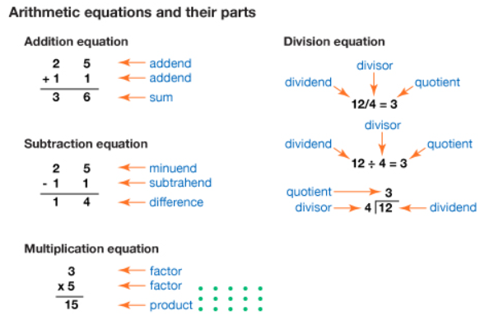

Slide 5
https://www.risingstars-uk.com/blog/november-2015/the-value-of-precise-mathematical-vocabulary?feed=rising-stars-blog
https://kids.britannica.com/kids/assembly/view/200345

Slide 6
ARM uses an inverted carry flag for borrow (i.e. subtraction). That's why the carry is set whenever there is no borrow and clear whenever there is. This design decision makes building an ALU slightly simpler which is why some CPUs do it.

Slide 7
; This is the only program file required in the project
AREA Test, CODE, READONLY
EXPORT Reset_Handler
Reset_Handler
MOV r0, #05 ; load first value
MOV r1, #05 ; load second value
MOV r2, #15 ; load third value
ADD r3, r0, r1 ; r3 = r0 + r1
ADDS r4, r0, r1 ; r4 = r0 + r1 and update the Status Flags
SUBS r5, r0, r1 ; r5 = r0 - r1 and update the status flags
SUBS r6, r0, r2 ; r6 = r0 - r2 and update the status flags
stop BAL stop ; Continuous loop
END ; END directive to show nothing more

Slide 8
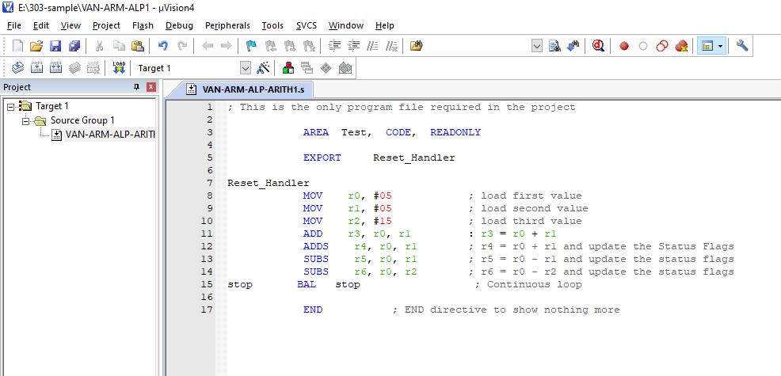

Slide 9
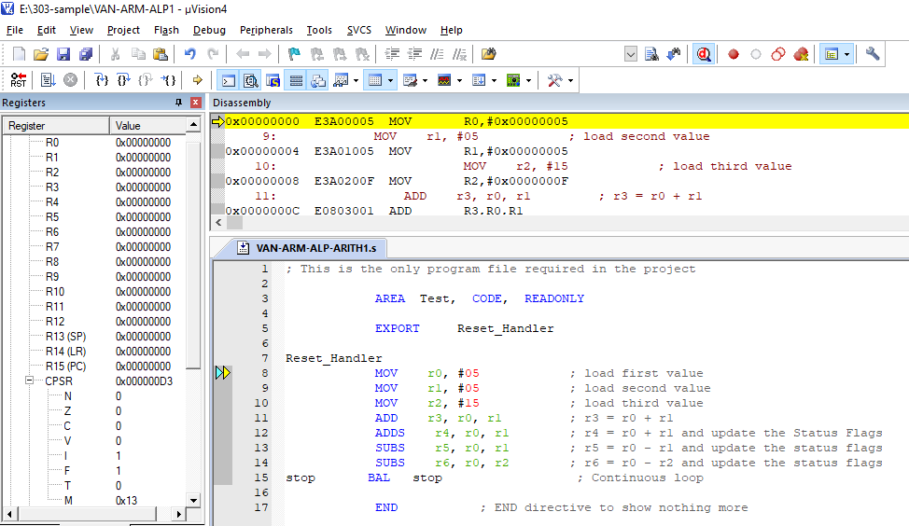
Initial Stage - Debugging Mode

Slide 10
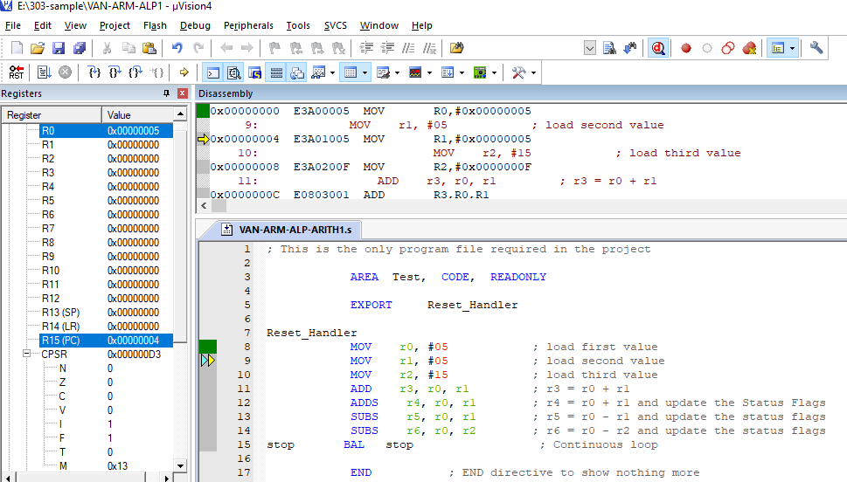
MOV r0, # 05 = > r0 = 0x00000005 No Upadte in Status Flags

Slide 11
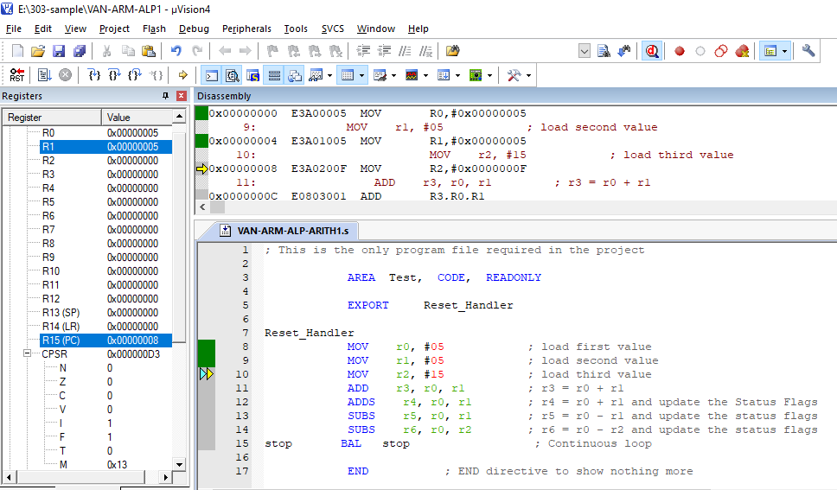
MOV r1, # 05 = > r1 = 0x00000005 No Update in Status Flags

Slide 12
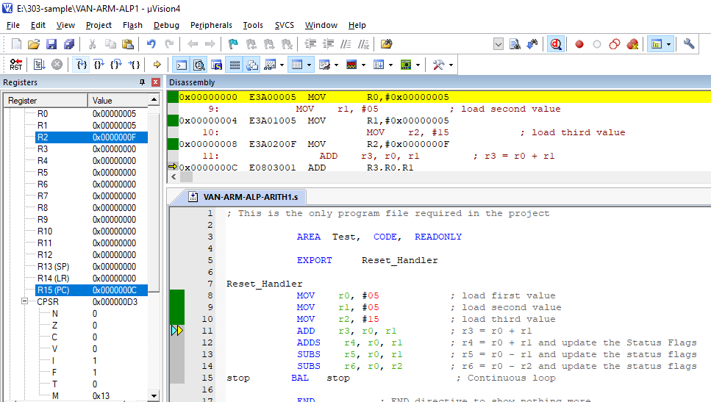
MOV r2, # 15 = > r2 = 0x0000000F No Update in Status Flags

Slide 13
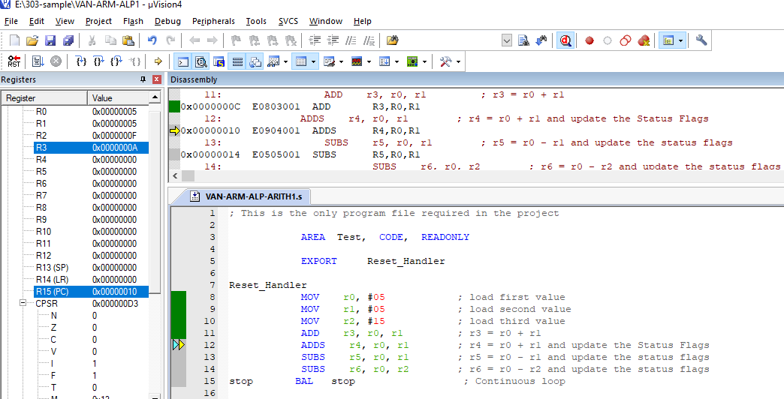
ADD r3, r0, r1 = > r3 = r0 + r1 and No Update in Status Flags

Slide 14
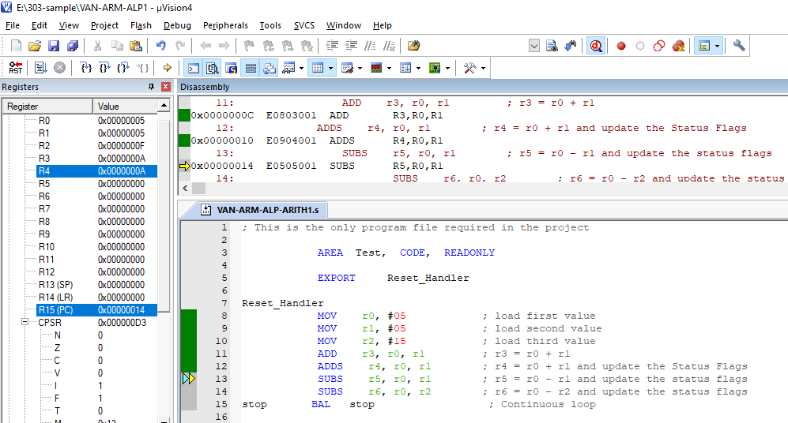
ADDS r4, r0, r1 = > r4 = r0 + r1 and Update in Status Flags as per result

Slide 15
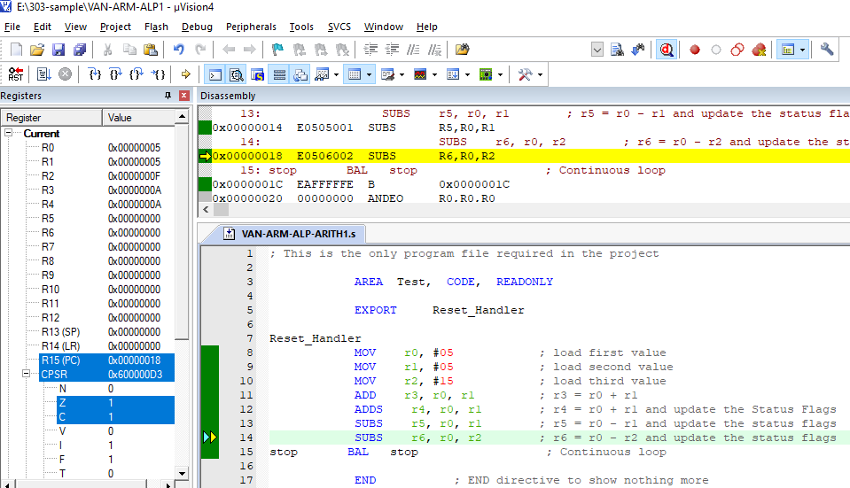
SUBS r5, r0, r1 = > r5 = r0 - r1 and Update in Status Flags as per result

Slide 16
Why Z =1 and C = 1 ???

Slide 17
r0 = 0x05 r1 = 0x05 r5 = r0 – r1 r5 = 0 ( a positive result) Z = 1 to reflect result is Zero C = 1 to reflect there is No Borrow ARM uses an inverted carry flag for borrow (i.e. subtraction). That's why the carry is set whenever there is no borrow and clear whenever there is Borrow. This design decision makes building an ALU slightly simpler which is why some CPUs do it.

Slide 18
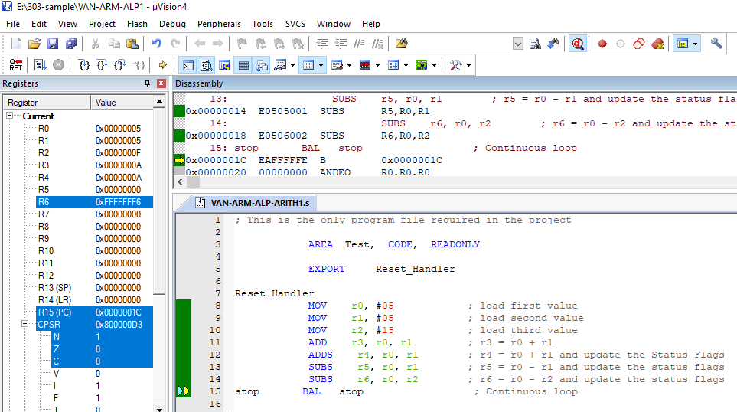
SUBS r6, r0, r2 = > r6 = r0 - r1 and Update in Status Flags as per result N= 1, Z = 0, C = 0 , V = 0

Slide 19
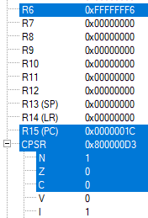
r0 = 0x05 r2 = 0x15 r6 = r0 – r2 r6 = 0xFFFFFFF6 Result is -10 = 0xFFFFFFF6 (2’s Comp) N = 1 to reflect result is Negative Z = 0 to reflect result is Non-Zero C = 0 to reflect there is No Borrow ARM uses an inverted carry flag for borrow (i.e. subtraction). That's why the carry is reset whenever there is borrow.
https://stackoverflow.com/questions/53065579/confusion-about-arm-documentation-on-carry-flag

Slide 20
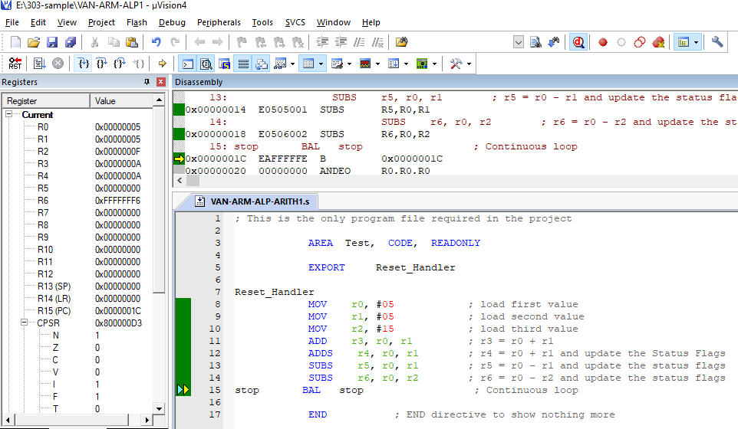
stop BAL stop ….. Stay There in the loop

Slide 21
Queries

